Slide 1

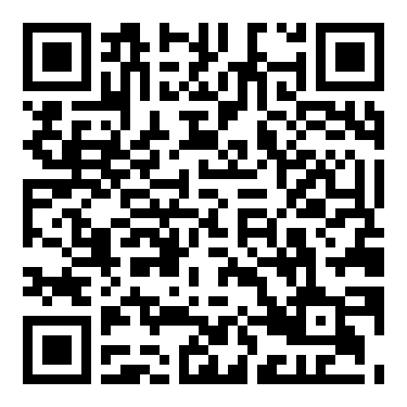
What you need to enjoy this presentation:
Laptop/Tablet with Internet
2. API Key from Score Card Recommended (Not Required) Collegescorecard.ed.gov/data/documentation
3. A Google Account
What you need to enjoy this presentation:​

Slide 2
Dynamic Documentation with Data Science Resources and Practices

Slide 3
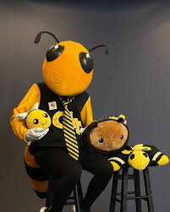
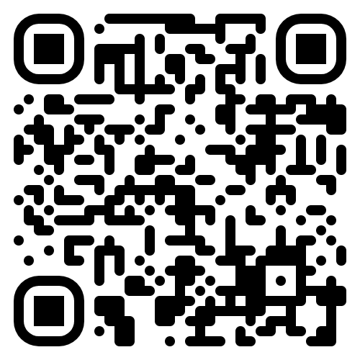
Introduction/ Background
2023
Earn(ing) MS
Presenting at SAIR
2022
Earned MS in Econometrics
Became a Data Scientist in IR
2019
Joined GT as Business Analyst
2018
Earned MBA
Analyst in private sector
Daniel Lyczak
Data Scientist
Georgia Institute of Technology
Institutional Research & Planning
2008
Finished Undergrad
Worked for DoE South Korea
Notes:
Image Source: Image source: https://www.instagram.com/buzz_gt/

Slide 4
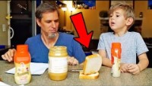
Video source: https://www.youtube.com/watch?v=Ct-lOOUqmyY

Slide 5
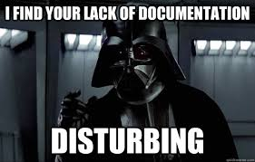
Documentation
Codifying/Structuring a process of data exploration to insight for internal and external users.
Why is
it used?
Documentation is a love letter to yourself / coworkers / constituents
Systems which promote business processes while (potentially) reducing redundancies
Allows for reproducibility, fact and error checking, and the development of automating *simple* stuff

Slide 6
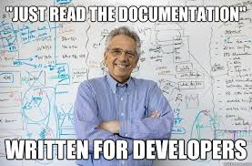
Documentation
Codifying/Structuring a process of data exploration to insight for internal and external users.
What makes
it good?
Readable, comprehensive while allowing skimming, clear, without sacrificing detail
Easy to find (single-sourced), up to date, easy to contribute to
Takes non-spatial → ‘visualizes’ it to amplify cognition and map it to 2D-3D space for its users

Slide 7
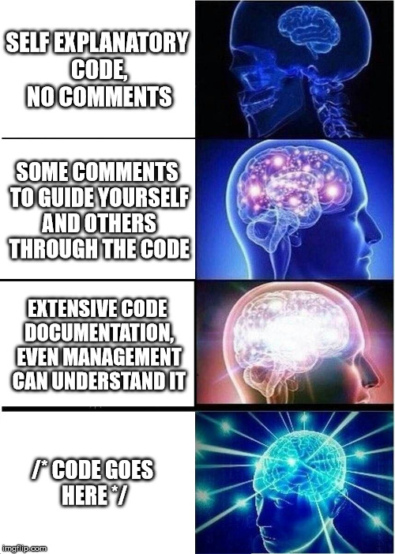
Documentation
Codifying/Structuring a process of data exploration to insight for internal and external users.
How do we consider our users?
Overview first. Zoom and Filter. Details on demand (Schneiderman’s Mantra)
Be lean minded, always thinking of if it is necessary to add X (Ian Malcolm)
Interactive?, tell a (static) story?, training?... (least common denominator / Provosts don’t code)

Slide 8


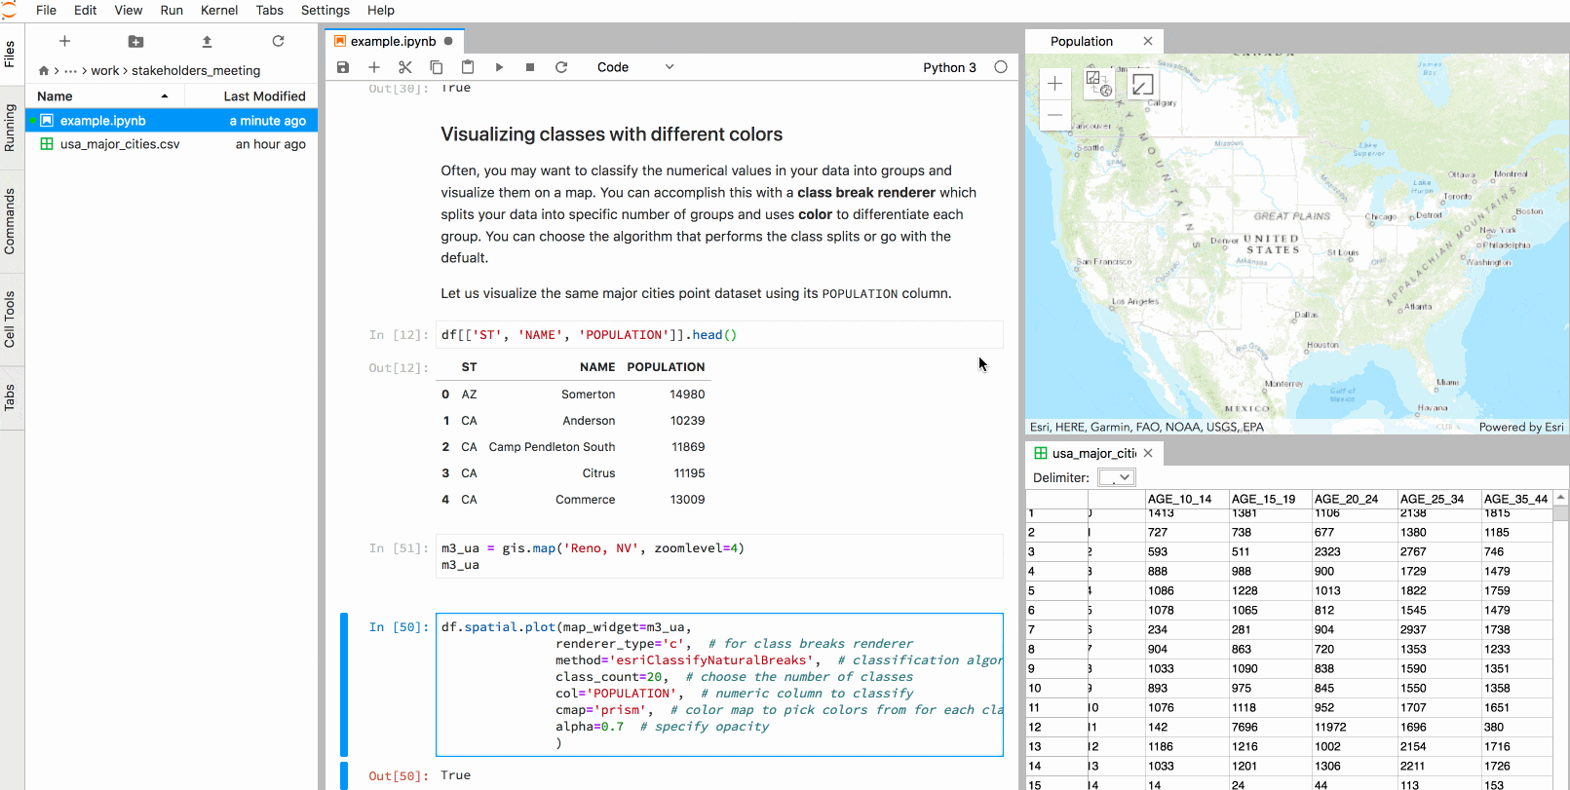
Notebooks
Free & Open Source
Largely Language Agnostic (Python is defacto)
Fully Integrated (VS Code, Cloud, GitHub)
Selling* Points
Ease** of customization
Ease** of shareability
Documentation + Computation
Storytelling
User accessibility
Notebooks => PB, J, Paper, Knife

Slide 9
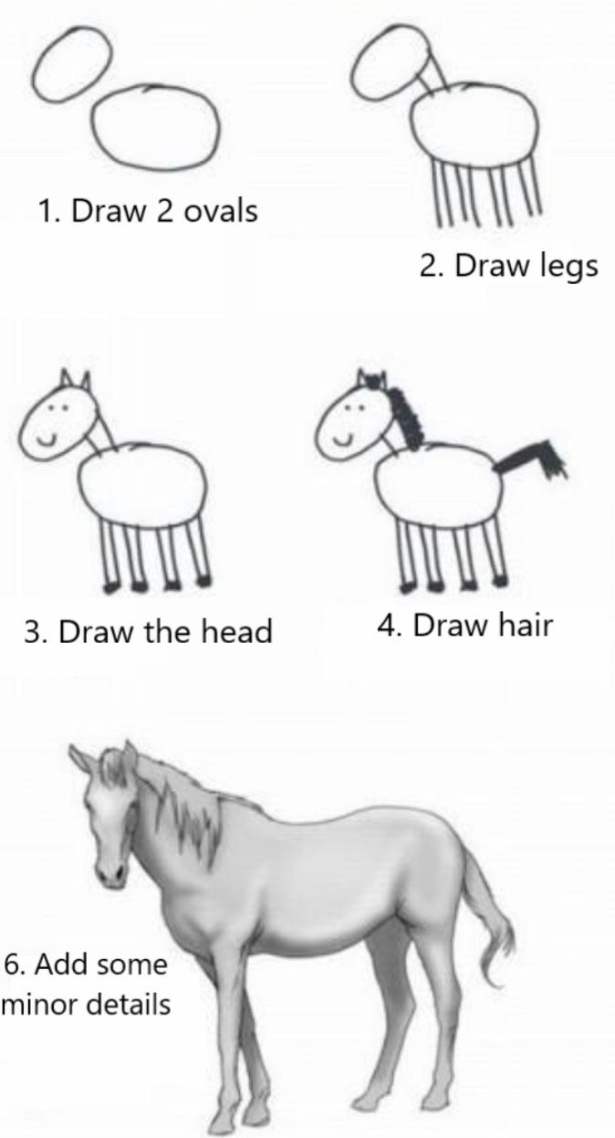
Setup
Python
Levels of Proficiency
6
Full Stack Python Developer
4
Comfortable with Python OOP
3
API / NumPy
2
Functions / Loops
1
Why are we talking about snakes?

Slide 10

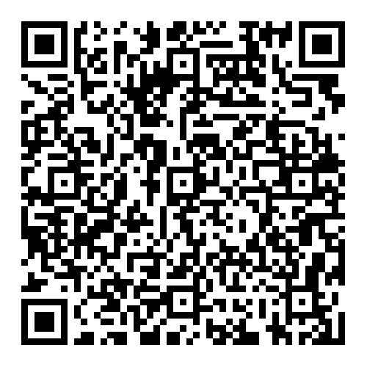

Notebook
https://colab.research.google.com/github/dlyczak3/SAIR_2023/blob/main/SAIR_Notebook.ipynb

Slide 11


Storytelling
Interactive

Slide 12
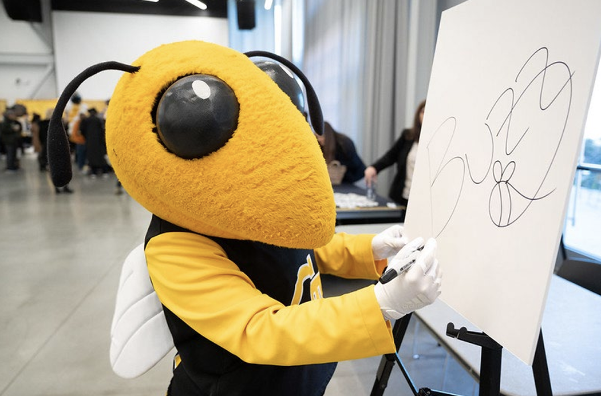
Dynamic Documentation with Data Science Resources and Practices
Thank you!
Daniel Lyczak

